Slide 1
Nowcasting and forecasting the potential domestic and international spread of the 2019-nCoV outbreak originating in Wuhan, China: a modelling study
Gwangwoo Kim
Dec. 12, 2022

Slide 2
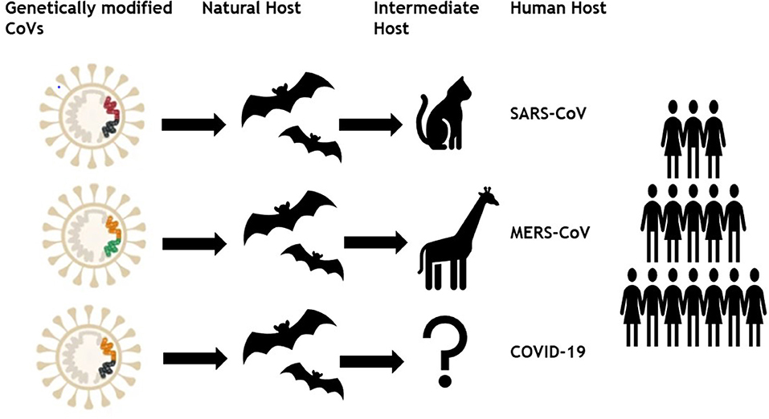
Introduction

Slide 3
Introduction
no subclinical manifestation
zoonotic viruses epidemiologically similar
similarly to the other four commonly circulating human CoVs

Slide 4

Introduction
A notable common characteristic of both is
that their basic reproductive number is low.
BUT, SUPERSPREDING!

Slide 5
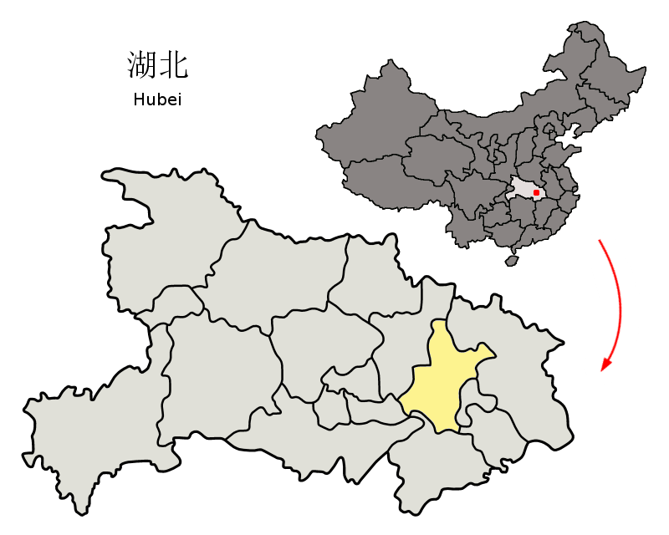

Introduction
A 55-year-old individual from Hubei province in China may have been the first person to have contracted COVID-19.

Slide 6
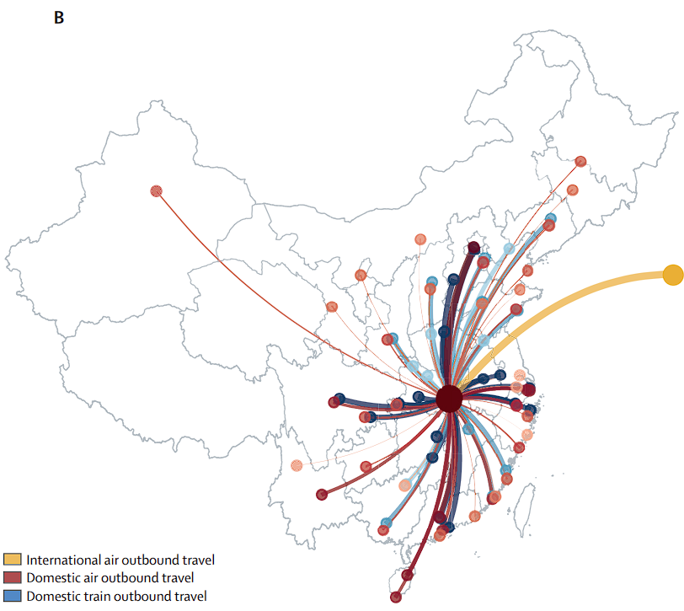

Introduction
Chunyun, also known as the Spring Festival travel season, is a period in China with extremely high traffic load around the Lunar New Year.

Slide 7
Introduction
This work shows:
(1) Infer the outbreak size of 2019-nCoV in Wuhan from the number of confirmed cases that have been exported to cities outside mainland China.
(2) Use this outbreak size estimate to project the number of cases that have been exported to other Chinese cities.
(3) We forecasted the spread of 2019-nCoV both within and outside of mainland China.

Slide 8
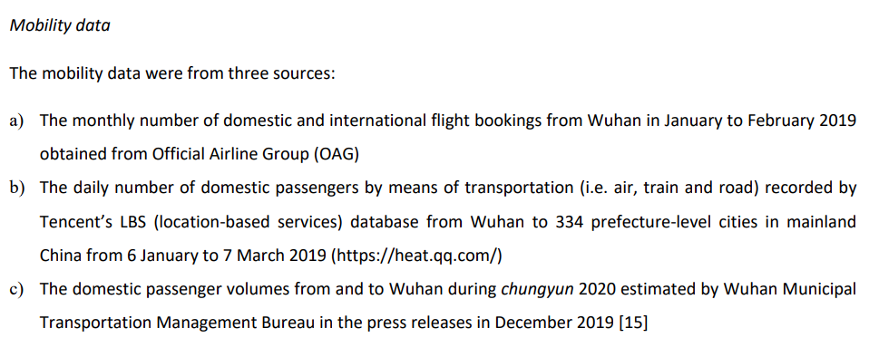
Method
Data collection

Slide 9
Method
Fact: The Chinese Center for Disease Control and Prevention (CDC) reported that only 43 (22%) of the 198 confirmed cases in its outbreak investigation had been exposed to the Huanan seafood wholesale market.
Assumption 1: During Dec 1–31, 2019, the epidemic in Wuhan was seeded by a constant zoonotic force of infection that caused 86 cases in our baseline scenario.

Slide 10
Method
Fact 2: Both 2019-nCoV and SARS-CoV could cause self-sustaining human-tohuman transmission in the community.
Assumption 2: The serial interval of 2019-nCoV was the same as that of SARS-CoV in Hong Kong (8.4 days).
Assumption 3: The incubation period of 2019-nCoV was similar to that of SARS-CoV and MERS-CoV (6 days).

Slide 11
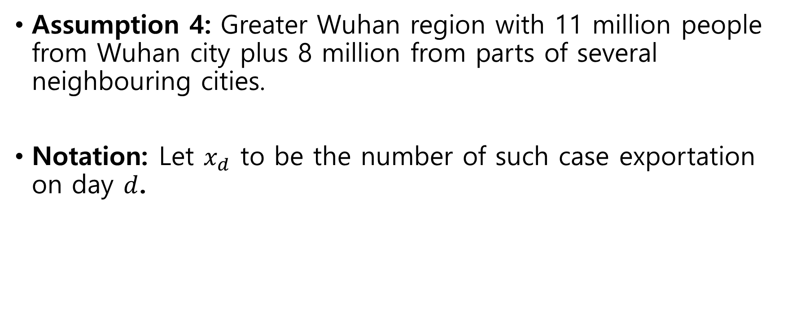
Method
Assumption 4: Greater Wuhan region with 11 million people from Wuhan city plus 8 million from parts of several neighbouring cities.
Notation: Let $x_{d}$ to be the number of such case exportation on day $d$.
6 days
(from incubation)
7 days
market closure
Dec 25, 2019
Dec 31, 2019
First outbreak (confirmation)
Jan 1, 2020
Jan 19, 2020
Jan 26, 2020
last outbreak (symptom)

Slide 12
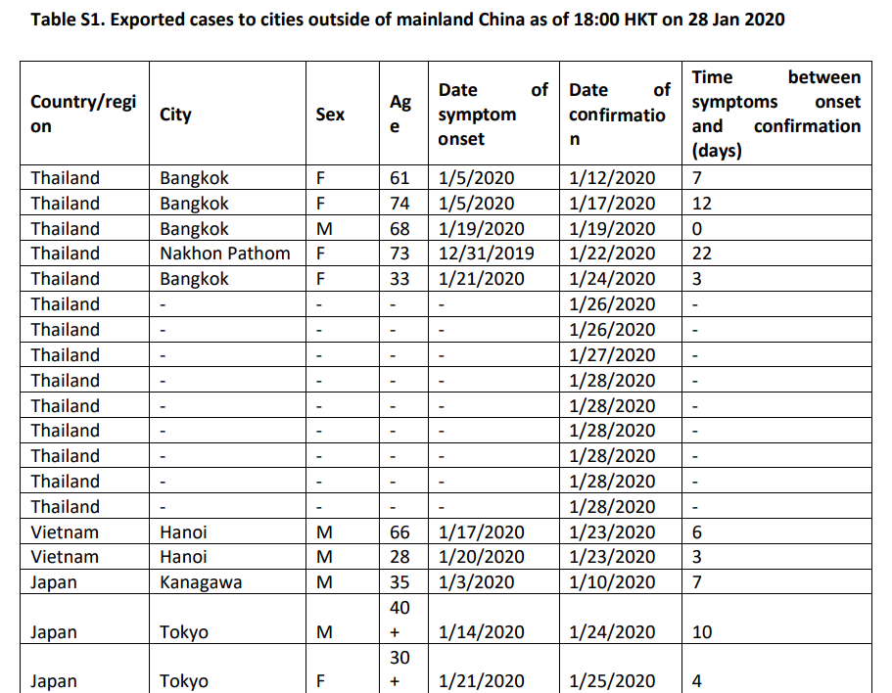
Method

Slide 13
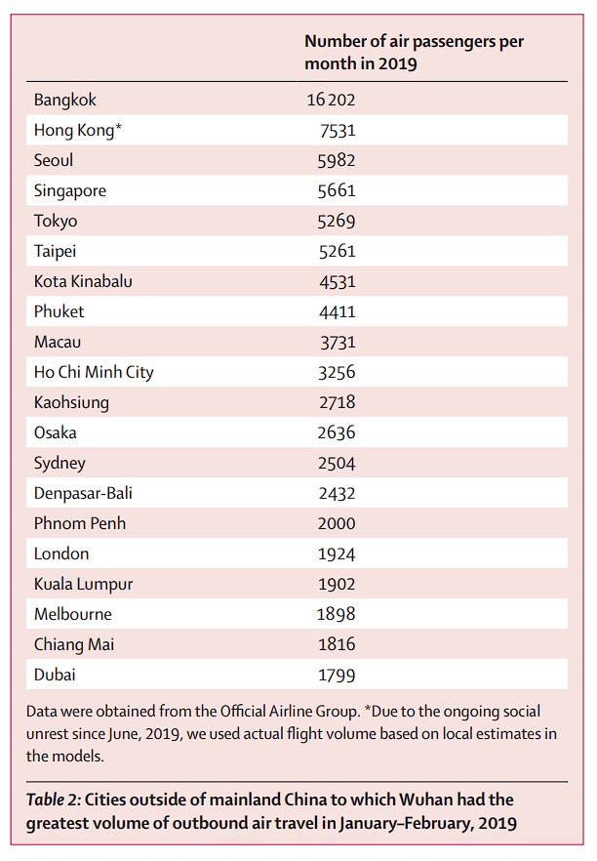
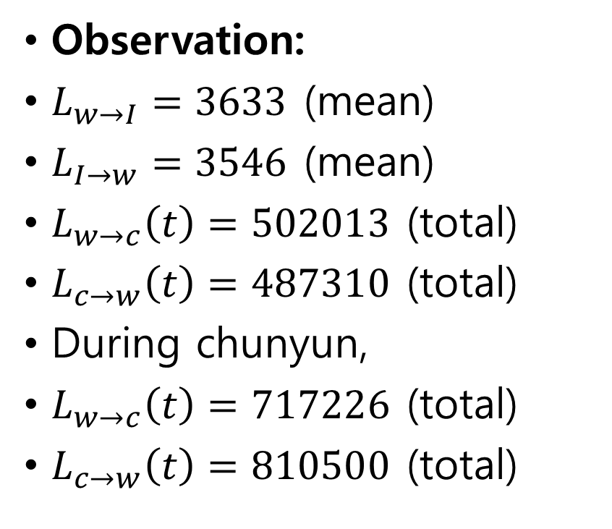
Method
Observation:
$L_{w→I}=3633$ (mean)
$L_{I→w}=3546$ (mean)
$L_{w→c}\left(t\right)=502013$ (total)
$L_{c→w}\left(t\right)=487310$ (total)
During chunyun,
$L_{w→c}\left(t\right)=717226$ (total)
$L_{c→w}\left(t\right)=810500$ (total)

Slide 14
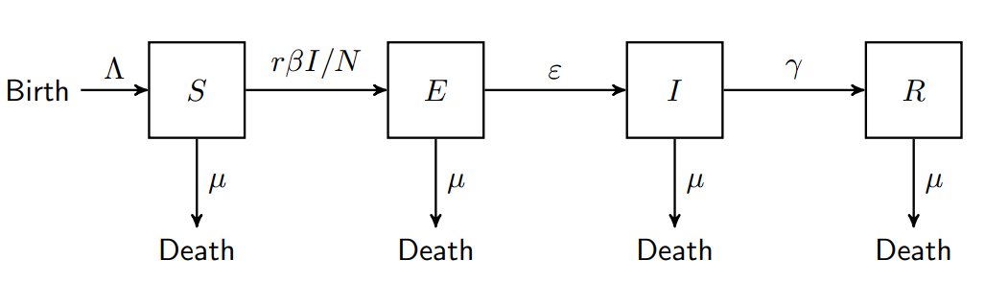
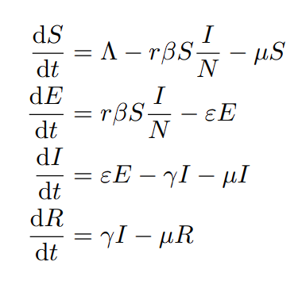
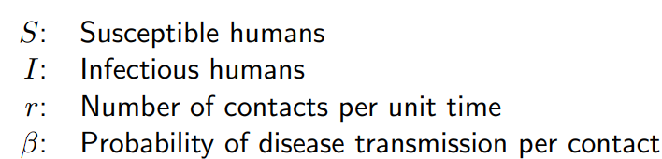


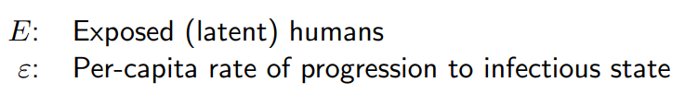


Method
Susceptible-Exposed-Infectious-Recovered (SEIR) Model

Slide 15
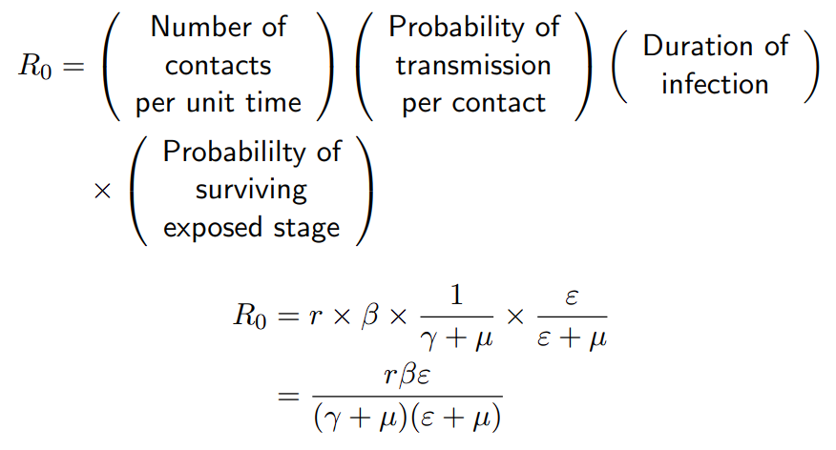
Method

Slide 16
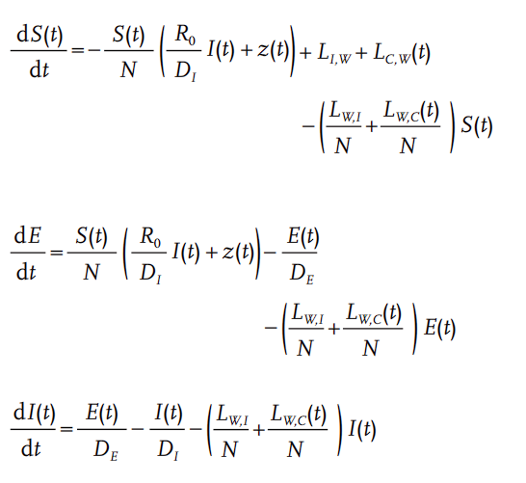
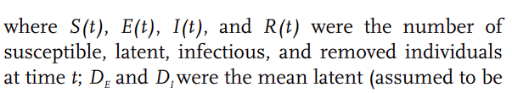
Method

Slide 17


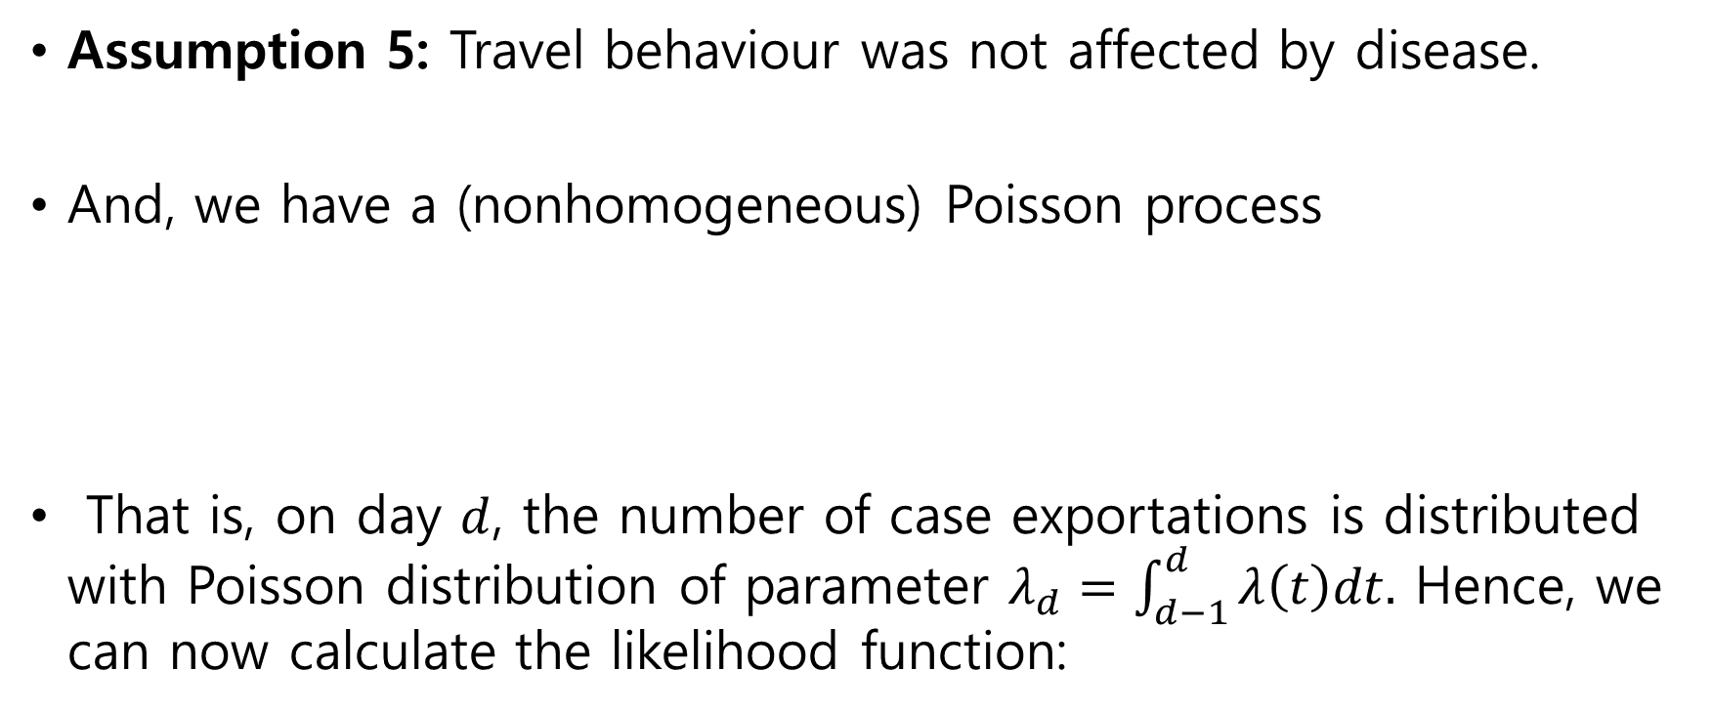
Method
Assumption 5: Travel behaviour was not affected by disease.
And, we have a (nonhomogeneous) Poisson process
That is, on day $d$, the number of case exportations is distributed with Poisson distribution of parameter $λ_{d}=\int_{d−1}^{d}{λ\left(t\right)dt.}$ Hence, we can now calculate the likelihood function:

Slide 18
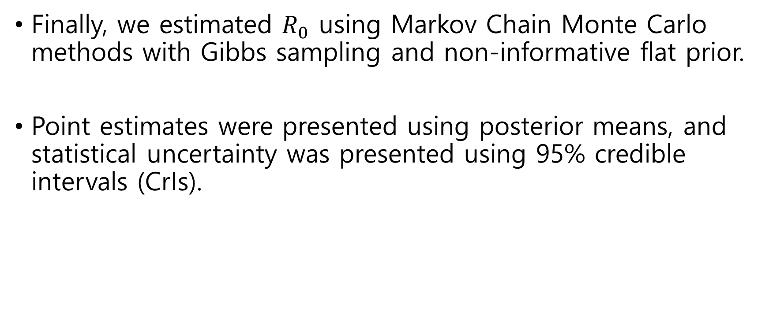
Method
Finally, we estimated $R_{0}$ using Markov Chain Monte Carlo methods with Gibbs sampling and non-informative flat prior.
Point estimates were presented using posterior means, and statistical uncertainty was presented using 95% credible intervals (CrIs).

Slide 19
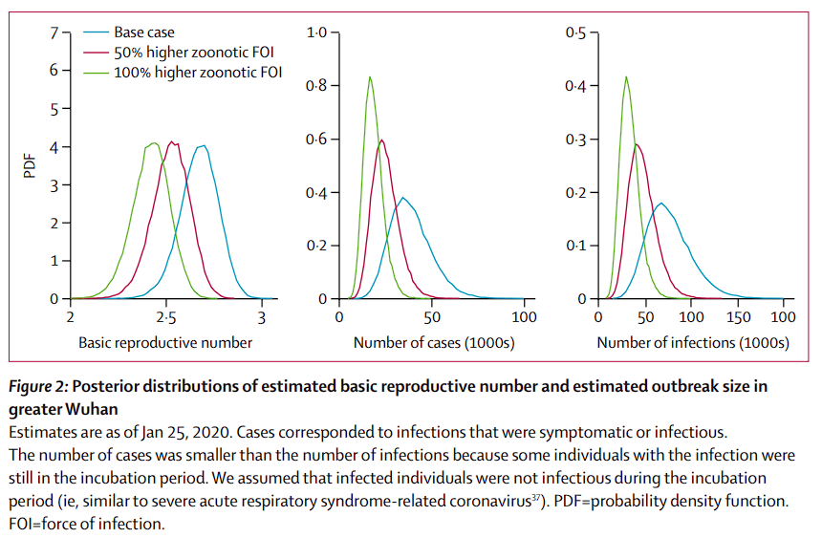
Results

Slide 20
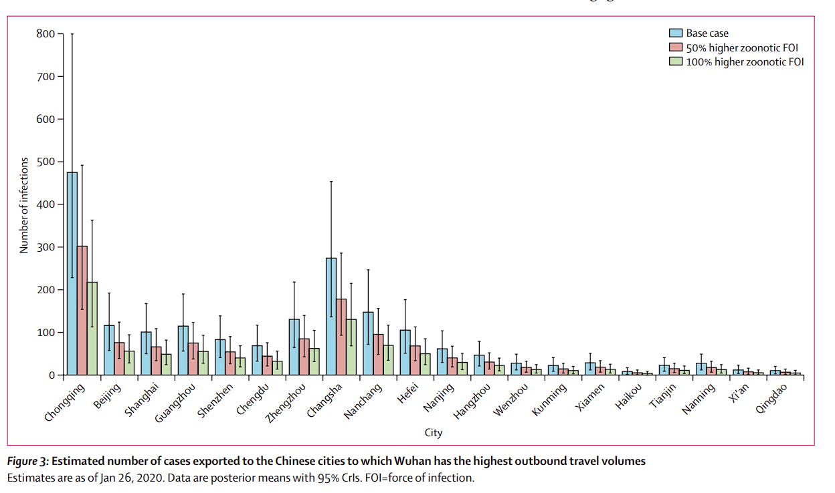
Results

Slide 21
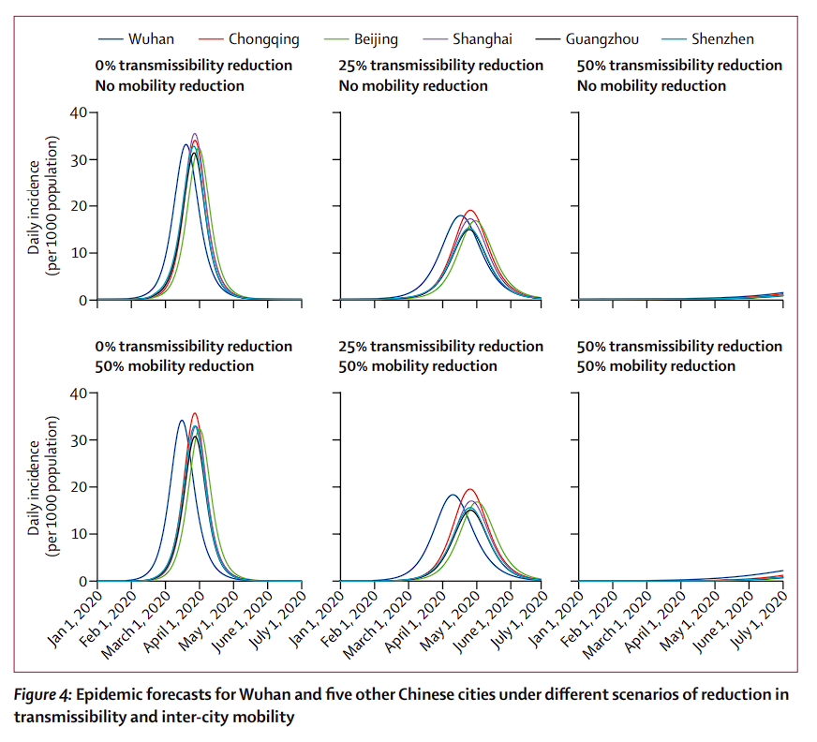
Results

